Slide 1



Bank Loan Case Study
Alankar Saxena

Slide 2


Bank Loan Case Study
Identify Missing Data
Identify Outliers
Analyze Data Imbalance
Univariate, Segmented Univariate and Bivariate Analysis
Correlation

Slide 3
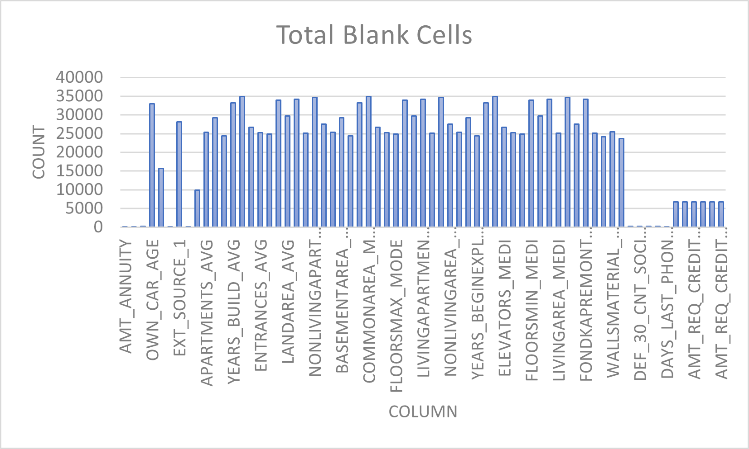
Identify Missing Data
In application_data, out of total 122 columns, 67 columns have missing values.
In previous_application, out of total 37 columns, 15 columns have missing values.
Bar chart shows the count of missing values in each column in application_data.
In both files, application_data and previous_application, continuous/numerical columns with missing values are filled with median of the particular column.
The categorical columns with missing value are filled with mode of the particular column.

Slide 4
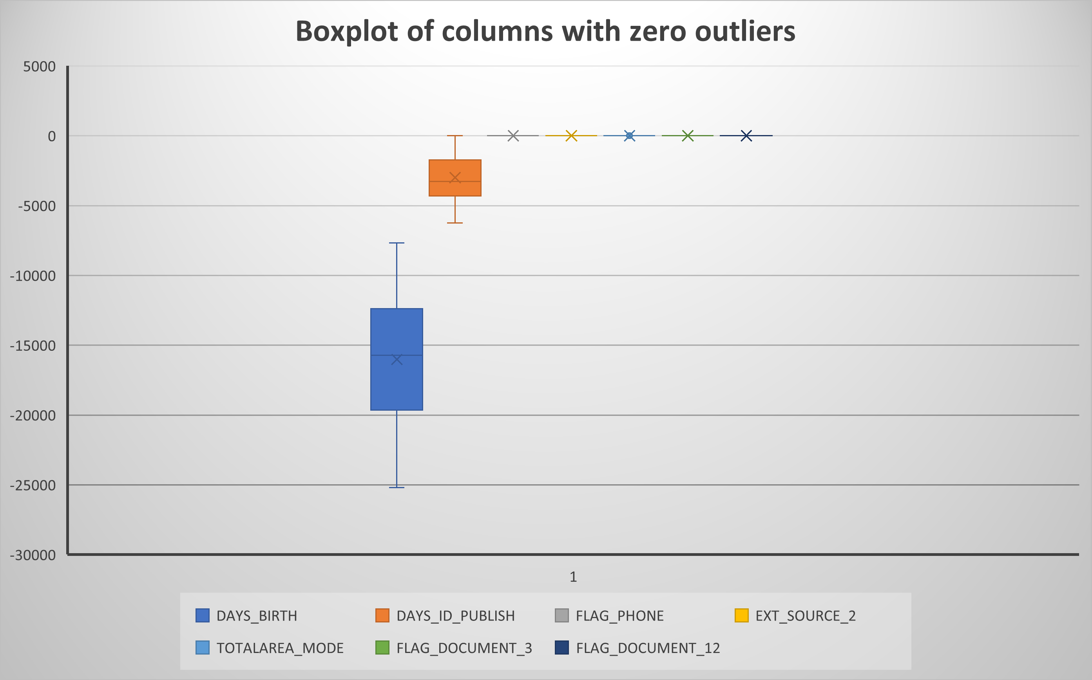
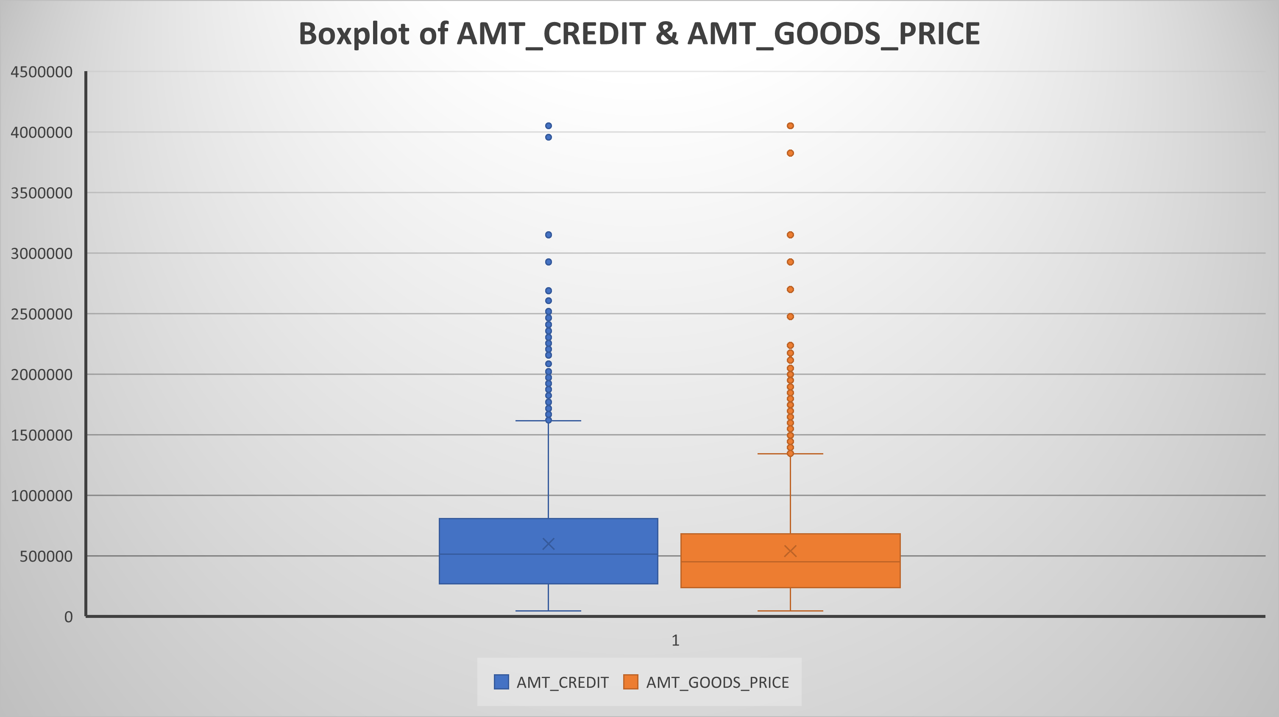
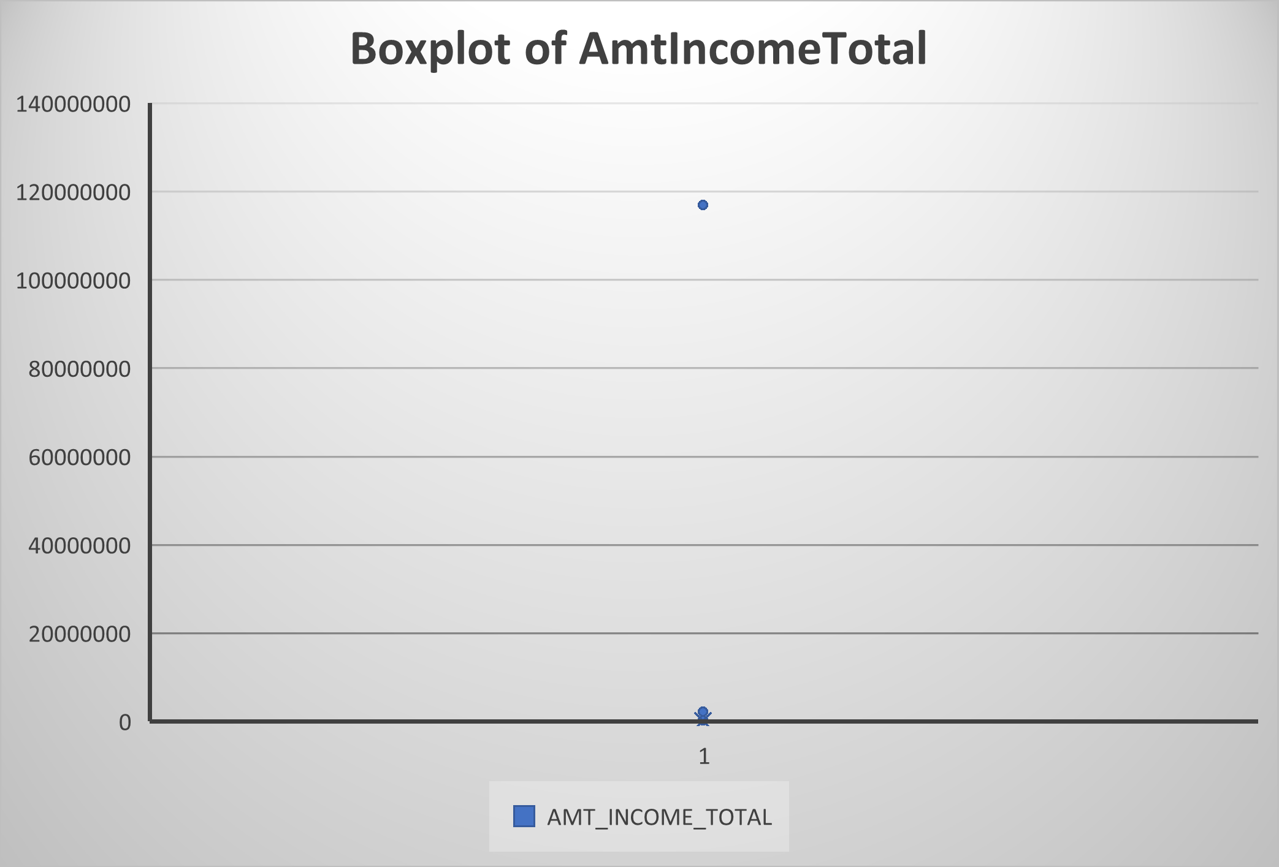
Identify Outliers
Histogram of all the columns with no outliers.
Histogram of Credit Amount and Goods Price.
Has very symmetrical and visible data with total outliers between 1000 to 2500.
Histogram of income amount.
It has one 2000+ outlier with one specific extreme value which changes it’s demography.

Slide 5
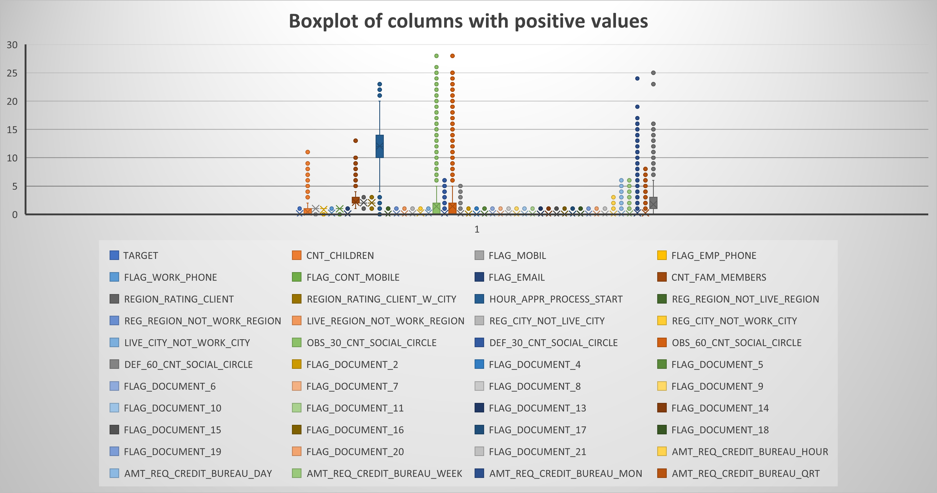
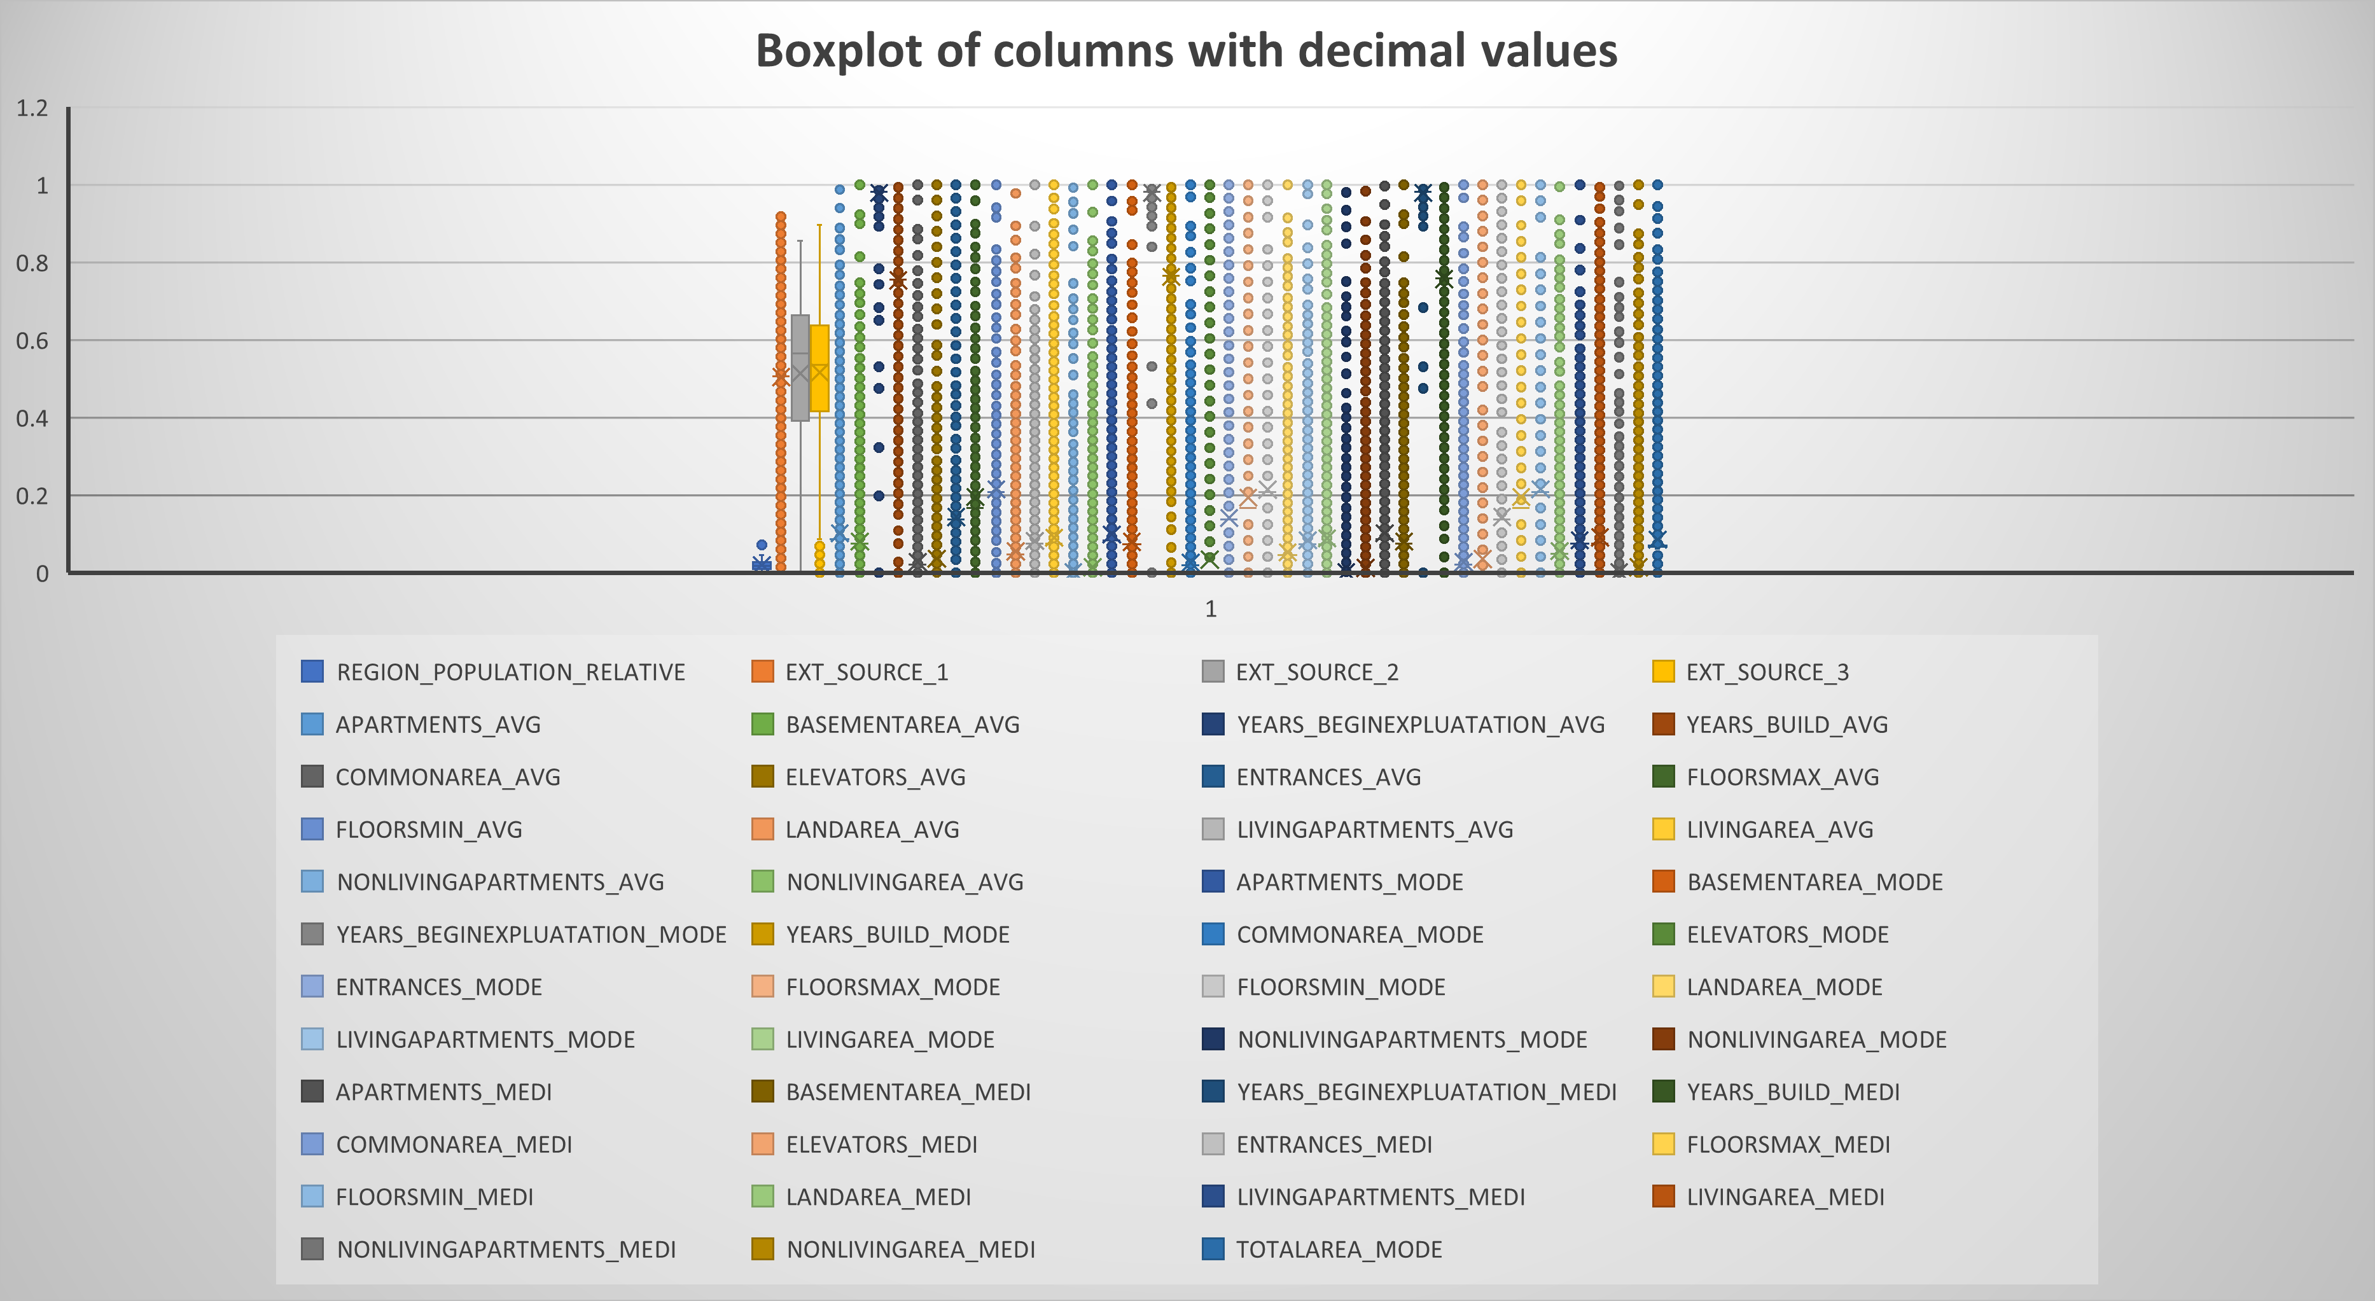
Boxplot of columns with positive values(more than 0).
Flags columns, counts columns and amount columns are considered in this.
Counts column have few outliers ( 600-700)
Flags column have large number of outliers as it only has two values.
Boxplot of columns with values less than 0.
It involves rating columns and normalized columns.
Count of outliers in these column is mostly very high.
Most of the columns’ outliers are not changed as most of the useful data columns are expectedly real and can not be changed except few columns.

Slide 6
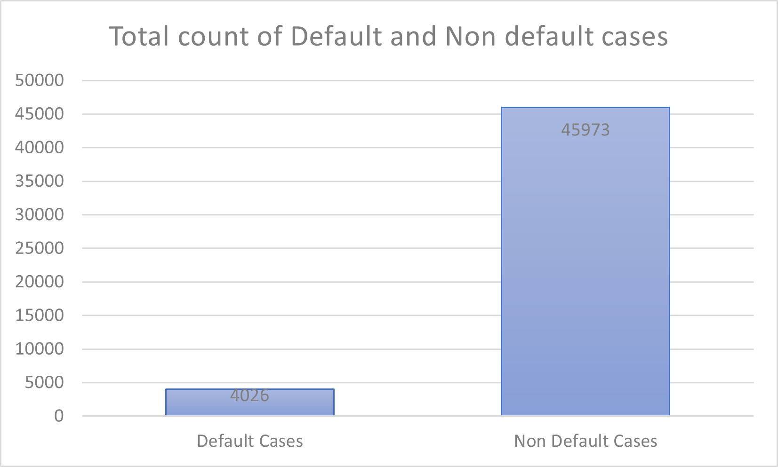
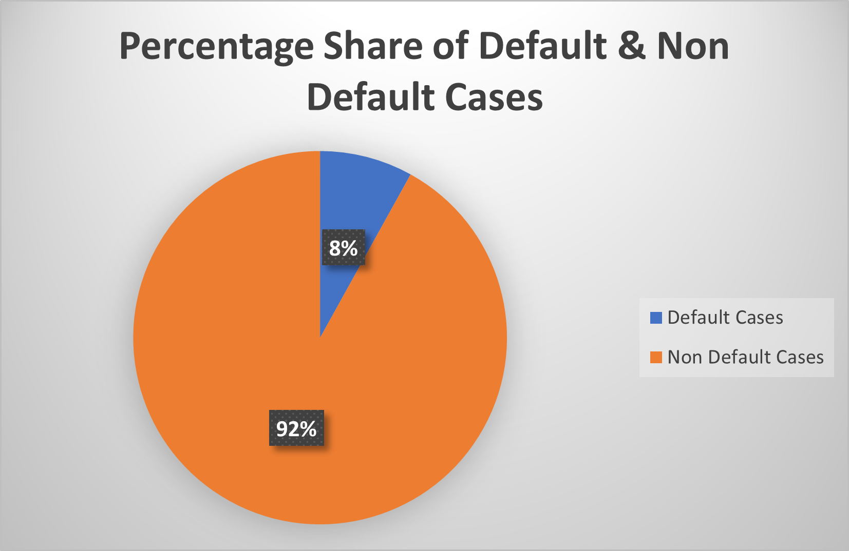
Analyze Data Imbalance
Ratio of Default Cases/ Non Default Cases= 0.088
Share of default cases in total cases= 0.08= 8%
Share of non default cases in total cases= 0.92 = 92%
In total applications+ offered cases, 92% customers have either no default history or are not likely to have any difficulty in repaying.
8% customers have either default history or are likely to have difficulty in repaying.
Although, in those 8% customers, customers’ application can be approved if their salary amount is considerable and they are employed for more than specific time or if their previous default was only for few days or weeks due to some genuine issue.

Slide 7
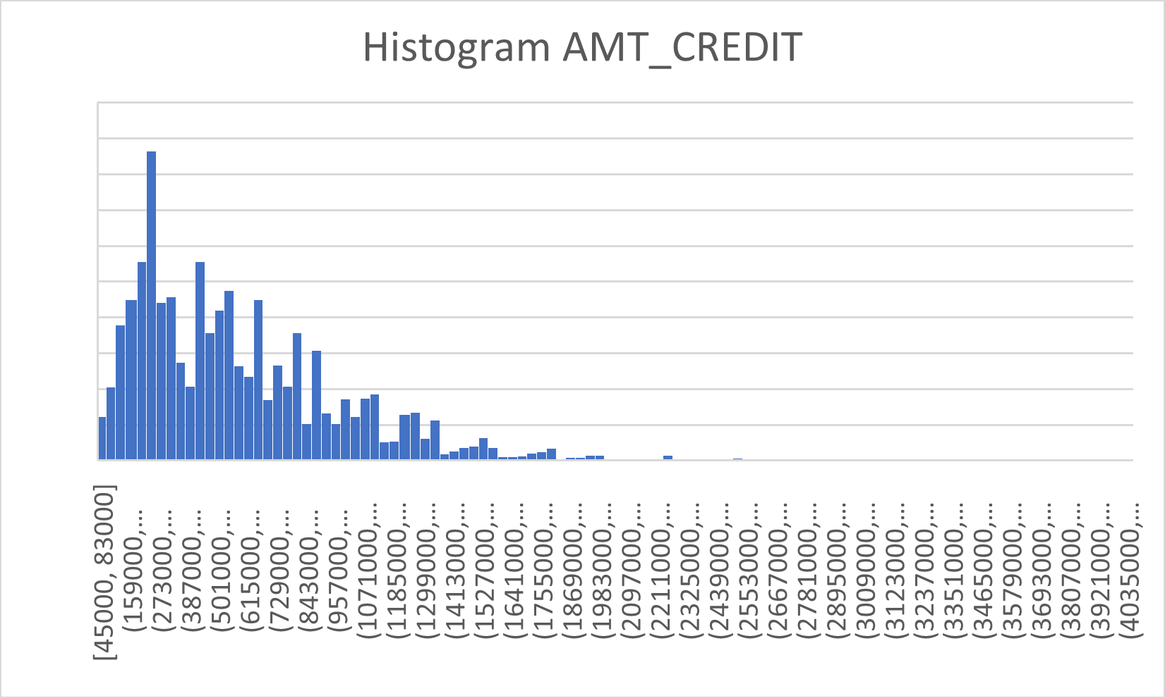
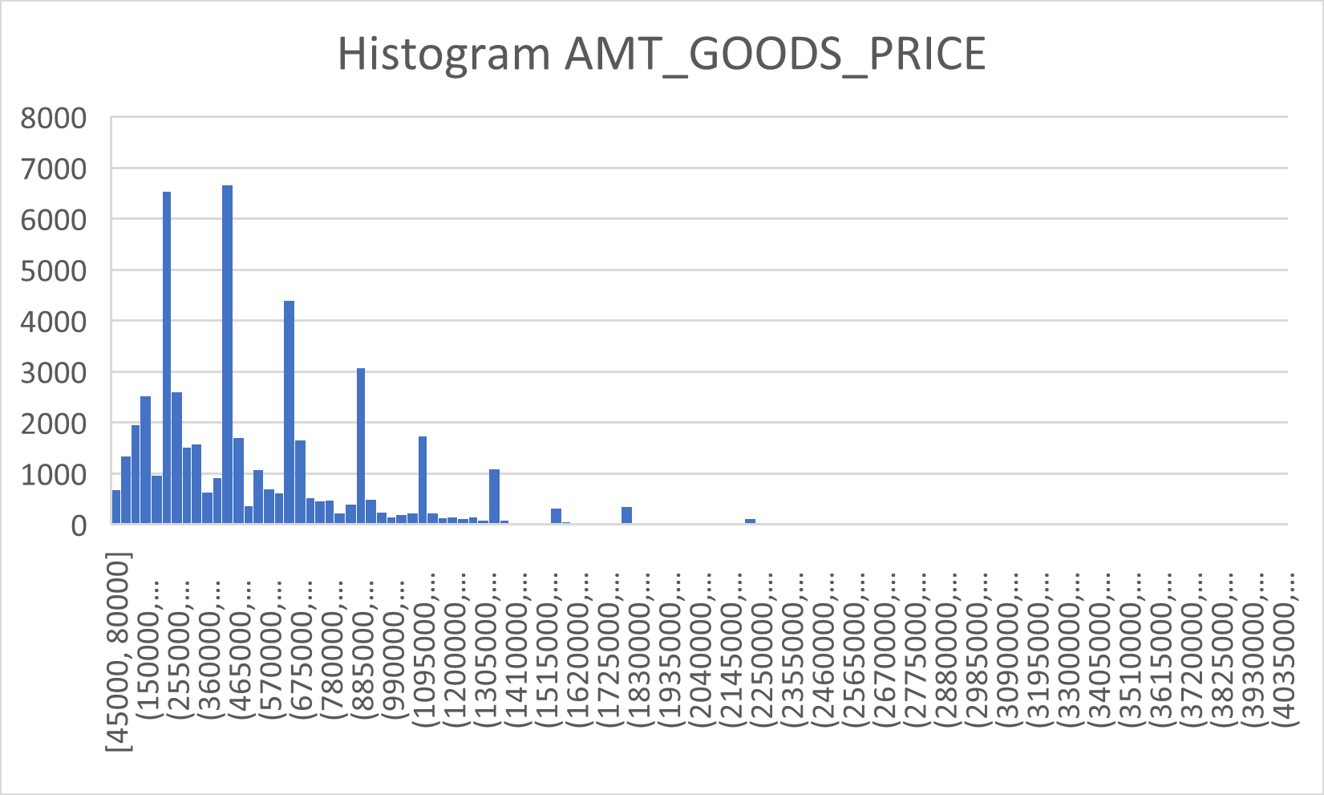
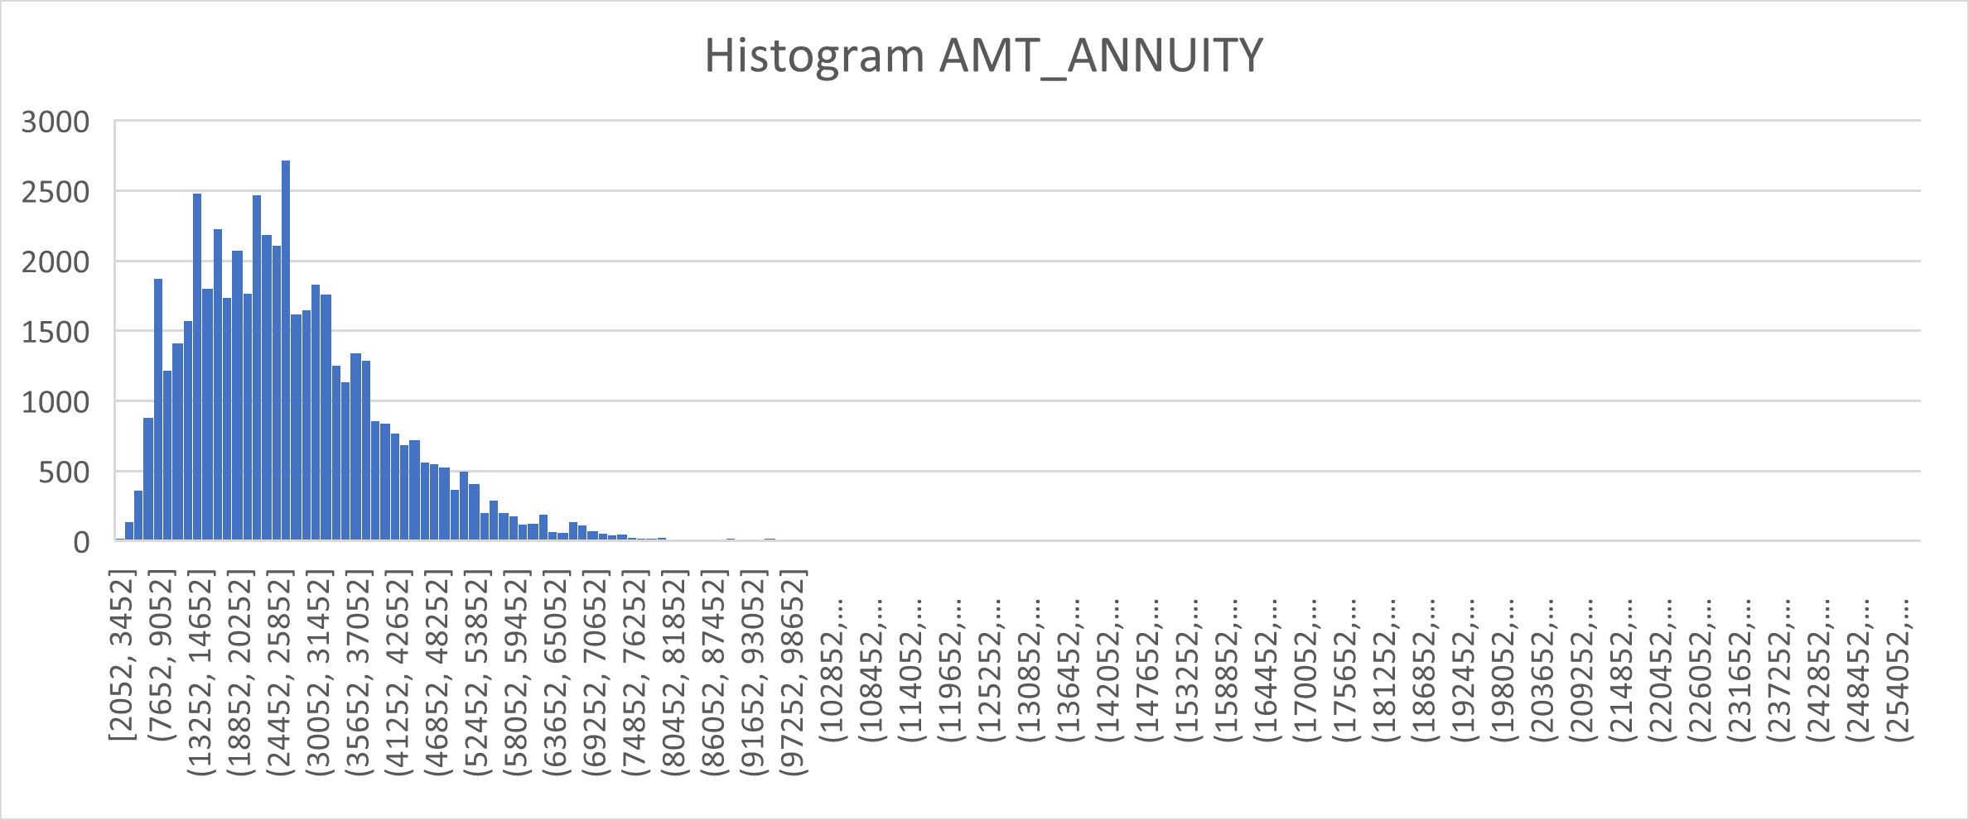
Univariate, Segmented Univariate and Bivariate Analysis
Credit amount histogram shows that mostly given credit amount is less than 900000.
Goods price histogram suggests that amount varies a lot in between similar values.
Annuity amount histogram shows that most of the time annuity is less than 400000 but it has many greater values as well.

Slide 8
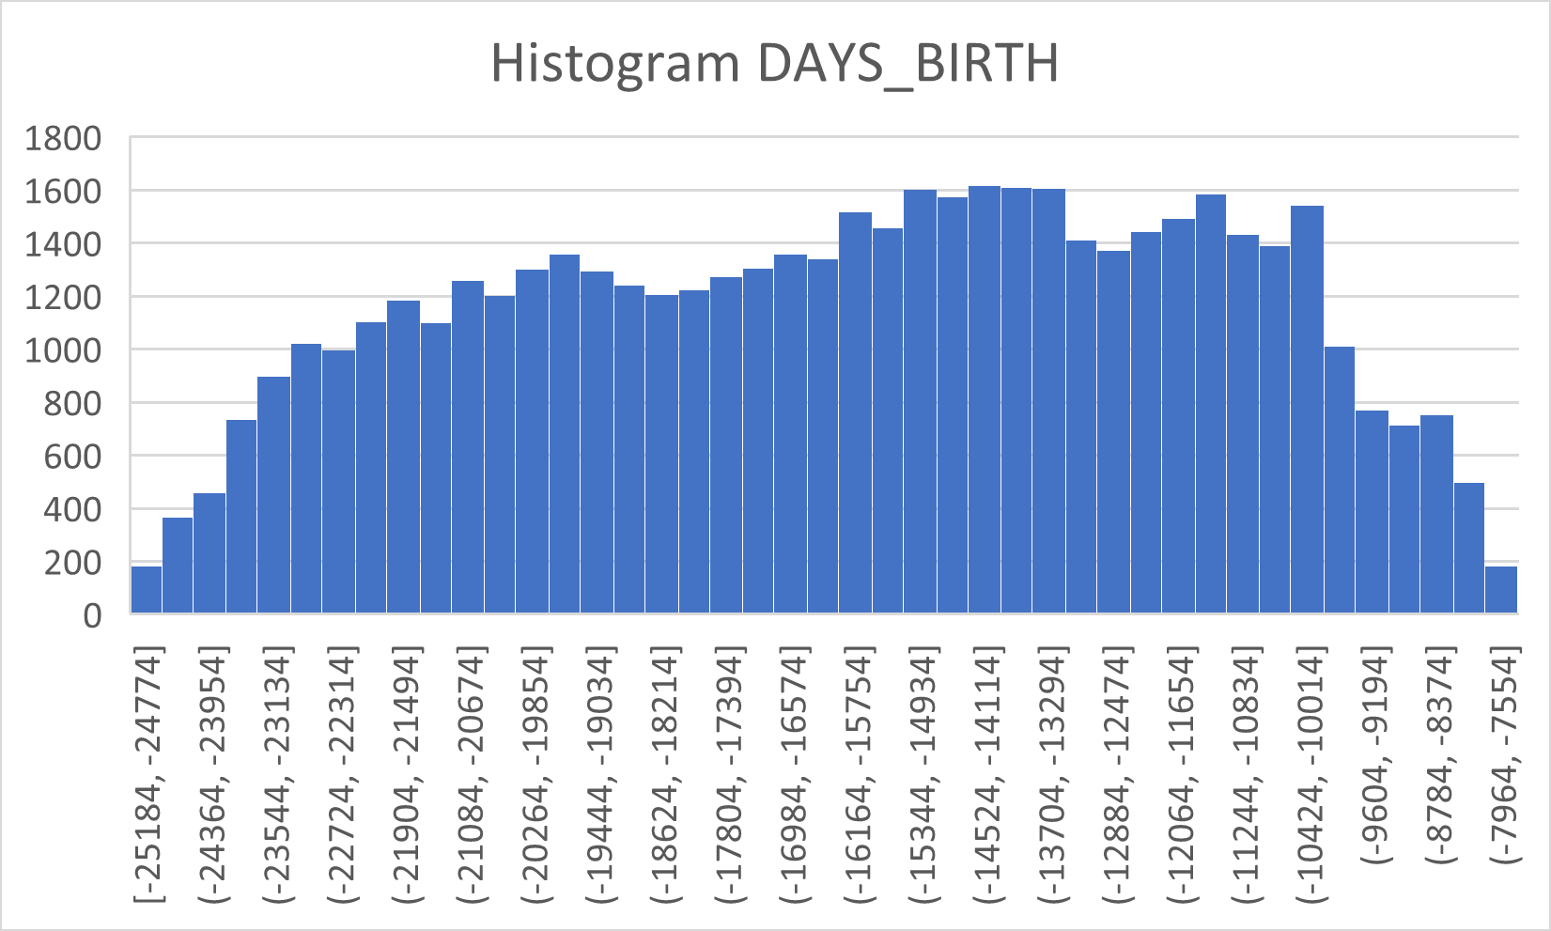
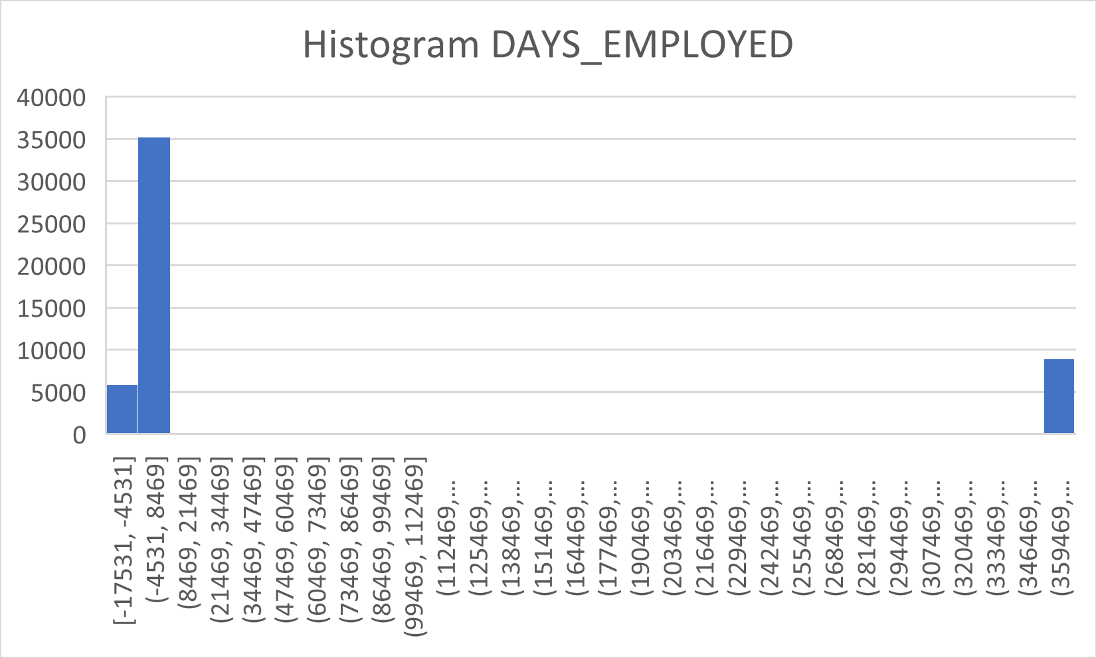
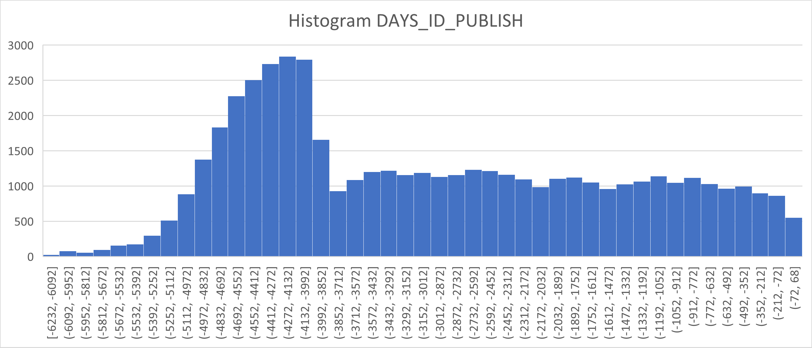
Histogram of days since birth shows a distributed data, which suggests that different age group people are being considered.
Histogram of days since employed shows less distributed data i.e. most of the people have been employed less than 8500 days.
Histogram of days since ID publish is also distributed with suggests different age group people are being considered.

Slide 9
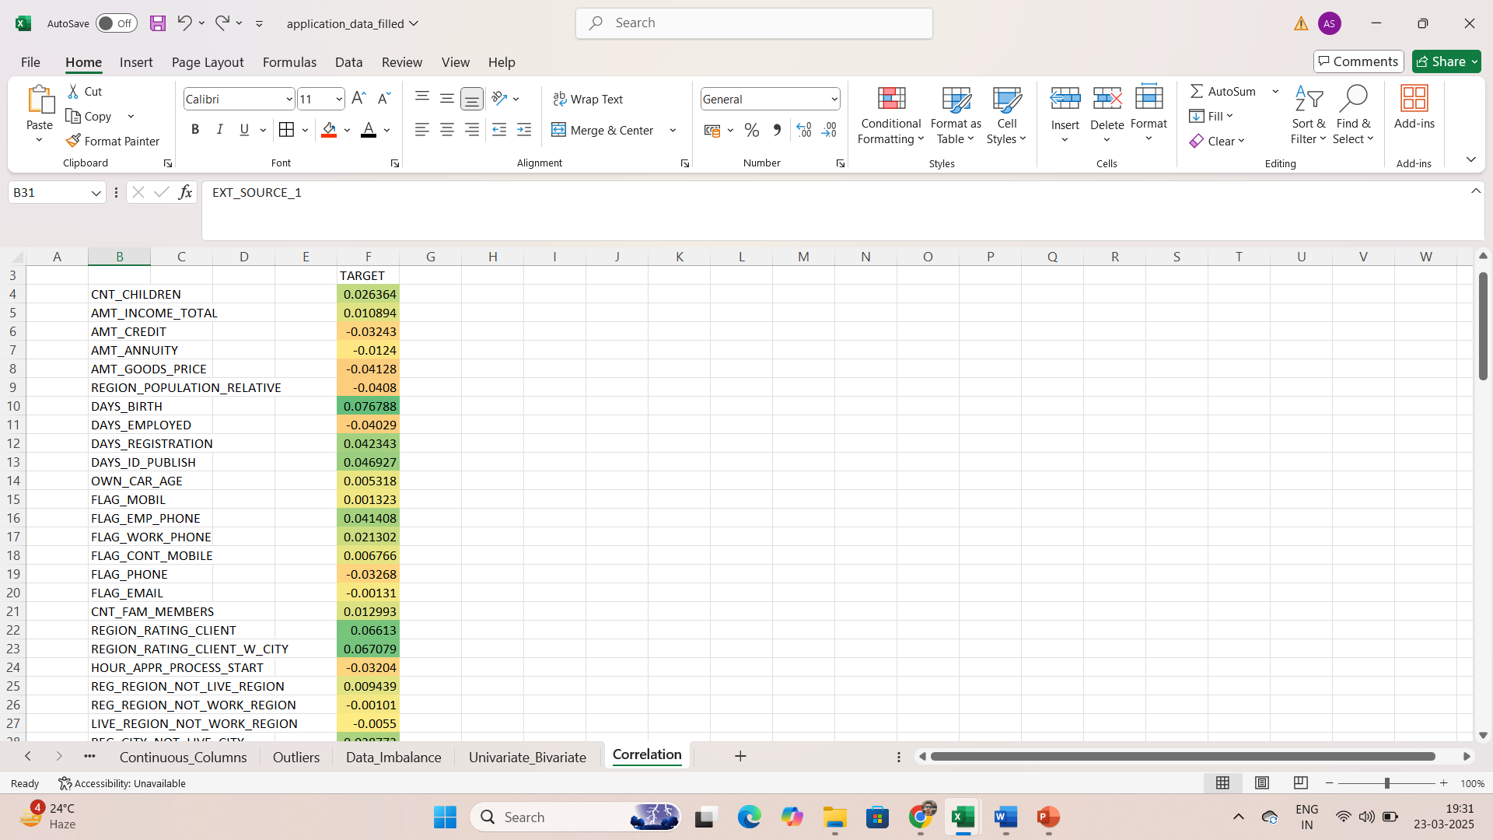
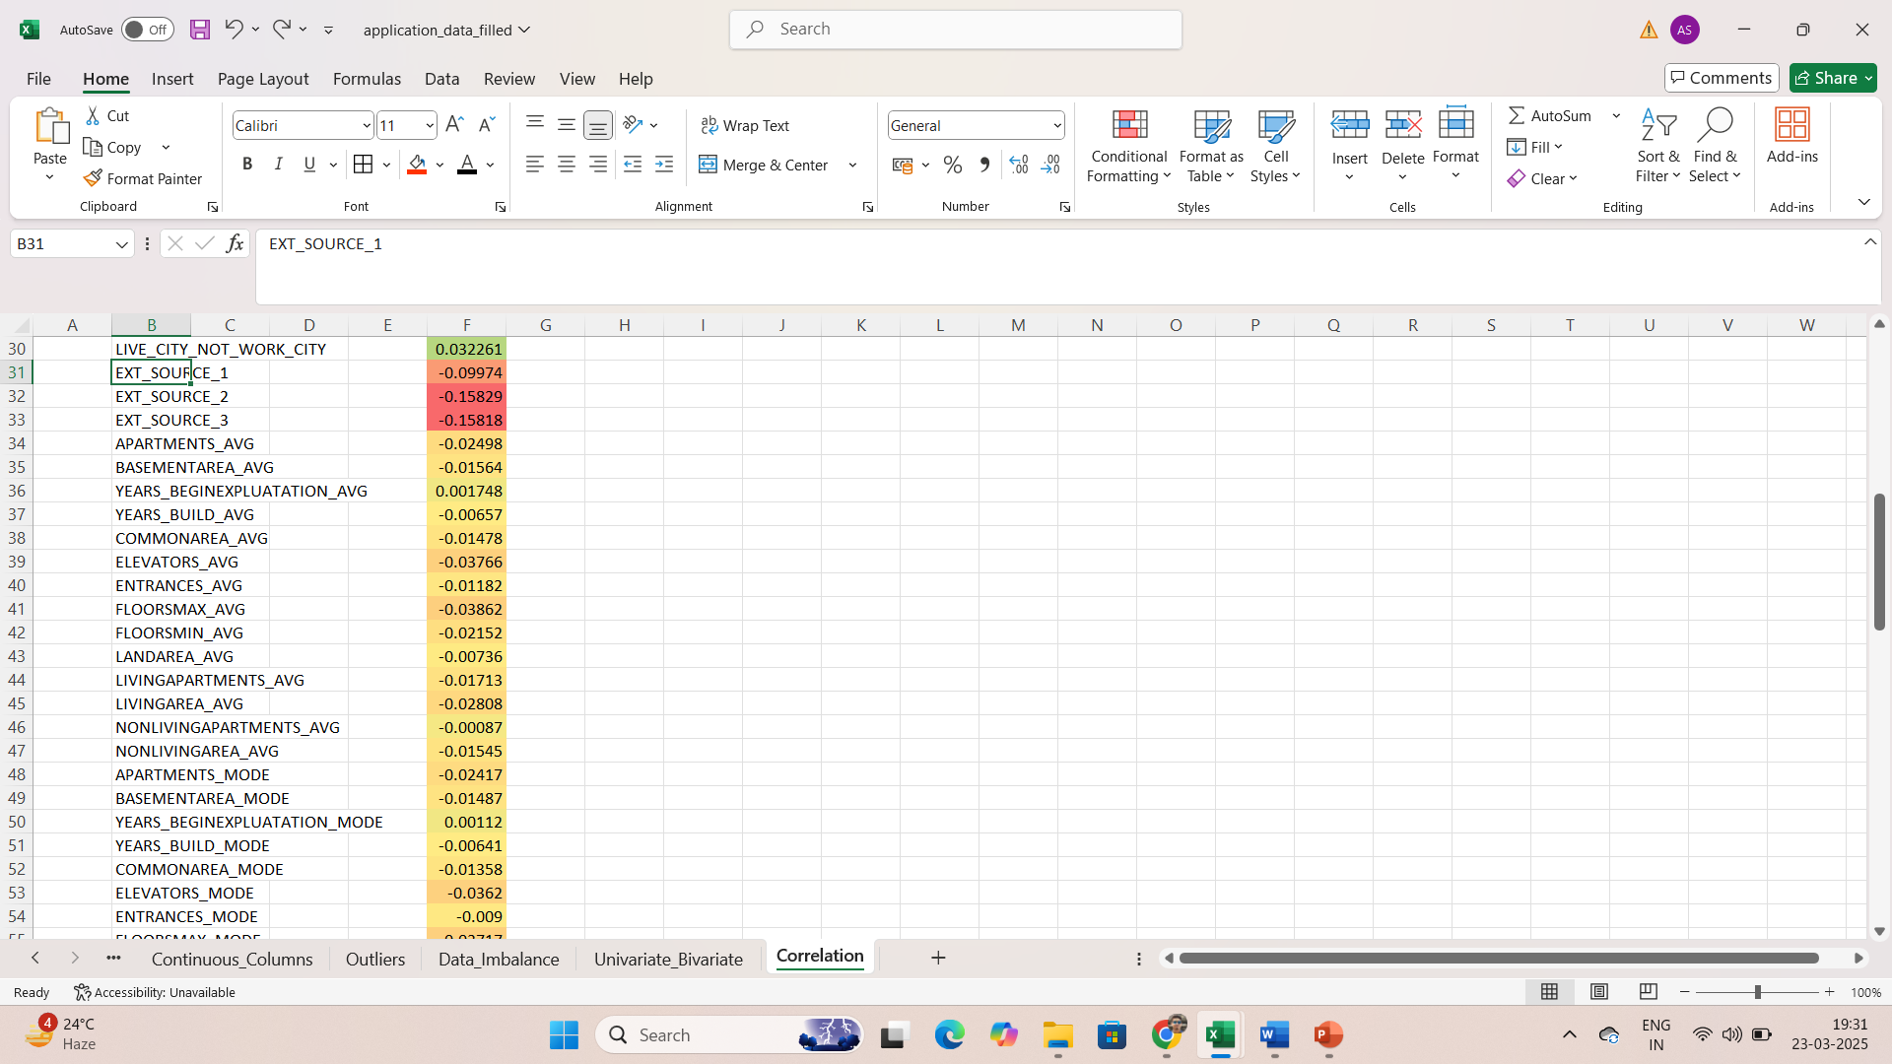
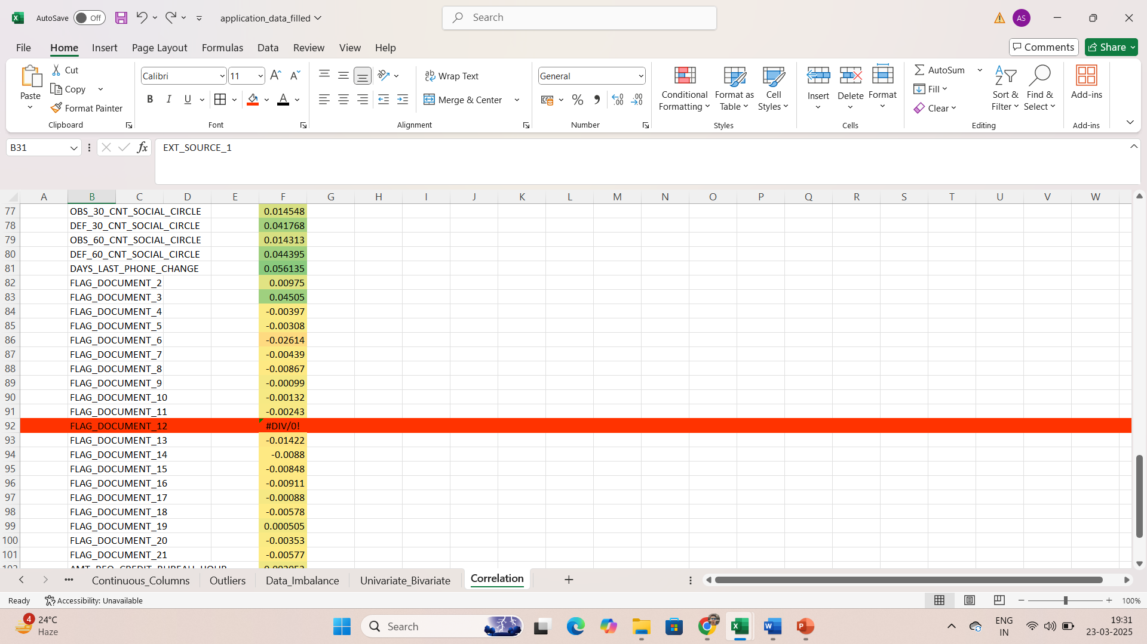
Correlation
Correlation between TARGET column and other continuous/numerical columns is shown above.
All the columns with shown green colour are highly corelated with TARGET column which suggests that it highly affects the default and non default tendency of the customers.
Columns shown with yellow or orange colour are mildly corelated with TARGET column, it mildly affects the tendency of default.
Columns with red colour are rarely or not corelated with TARGET column and have no affect.
FLAG_DOCUMENT_12 column has no correlation value as the whole column has only one value in all rows i.e. 0.

Slide 10
Link
application_data.csv
application_data_filled.csv
previous_application.csv

Slide 11
Conclusion
TARGET column shows the history or probable default cases so it is the most important column for consideration in approving the applications.
The customers with no default history or no probable default scenarios can be considered for approving the loan. Unless the ask for loan amount is greater than their eligibility or the amount of their mortgage.
The customers with default history can be considered for approval if their previous default was only once and it was for only few day or few weeks due to genuine reasons, otherwise their consideration should be denied.
The customers with probable default in future can have many reasons such as low income, low mortgage value, no mortgage, greater age etc. For such customers, it would be for best if the application is not considered.

Slide 12
THANK YOU
BY-
Alankar Saxena

